Slide 1
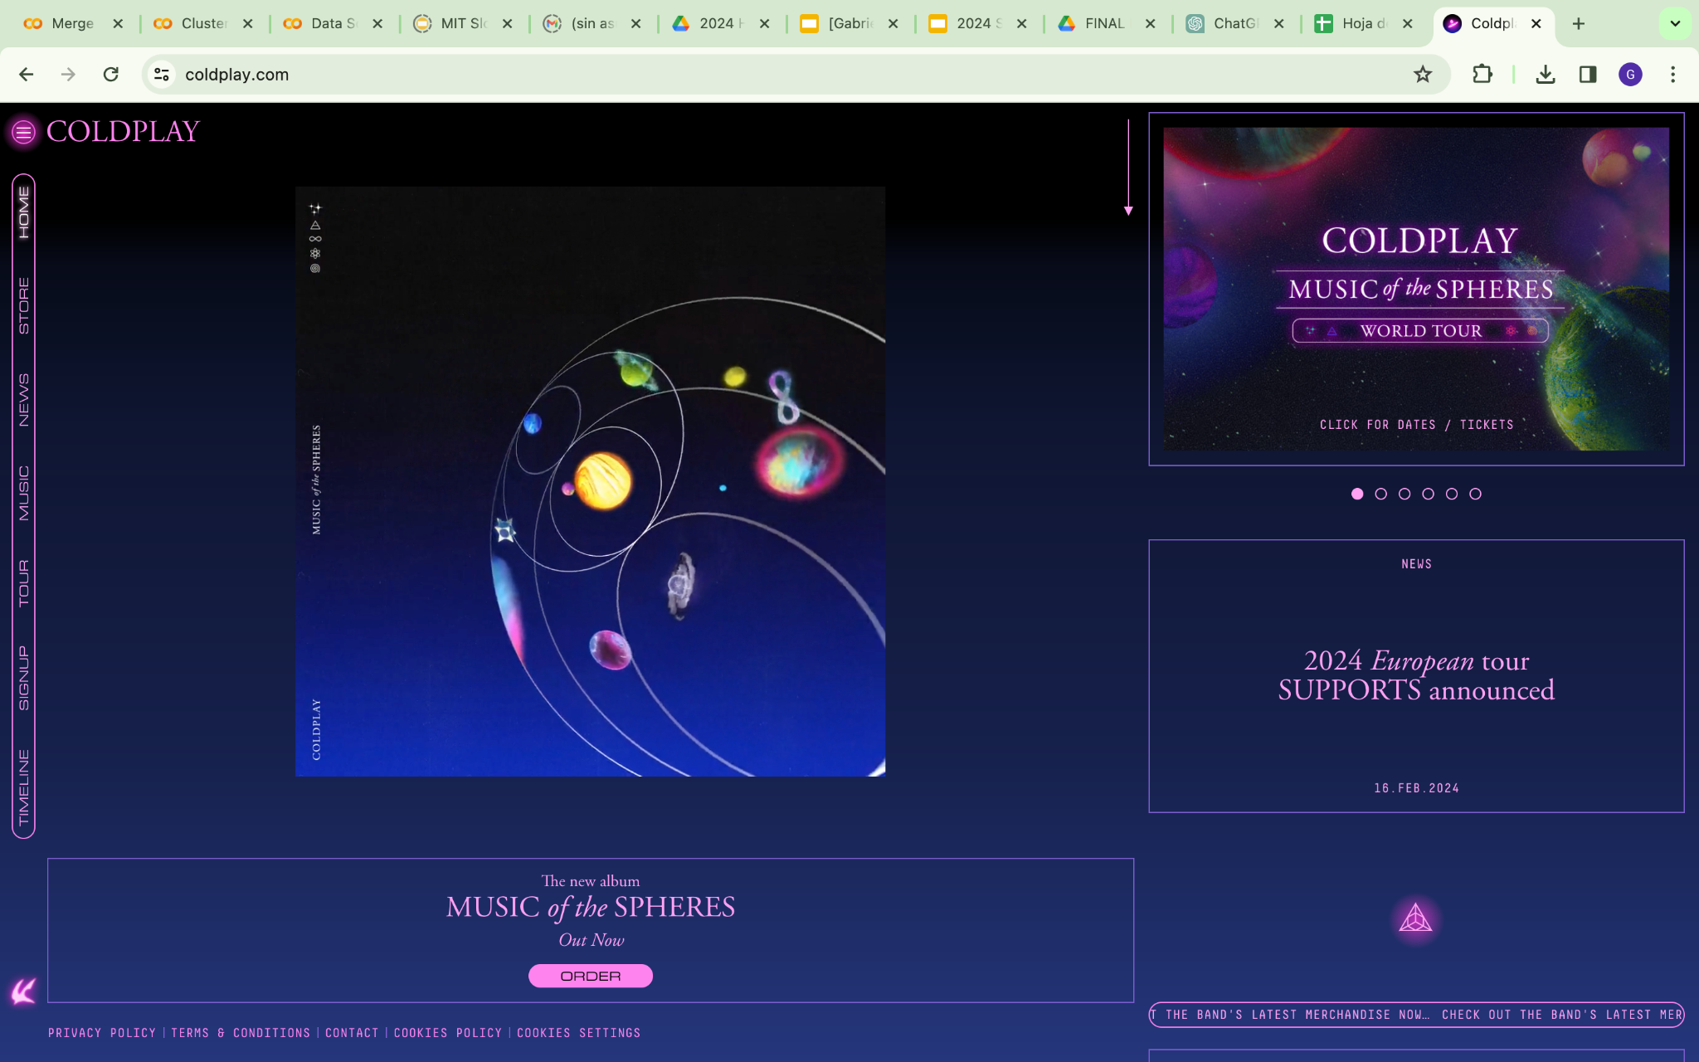
Coldplay Music of the Spheres USA Tour
Gabriel Mendoza, Google
Wasif Talukder, American University

Slide 2
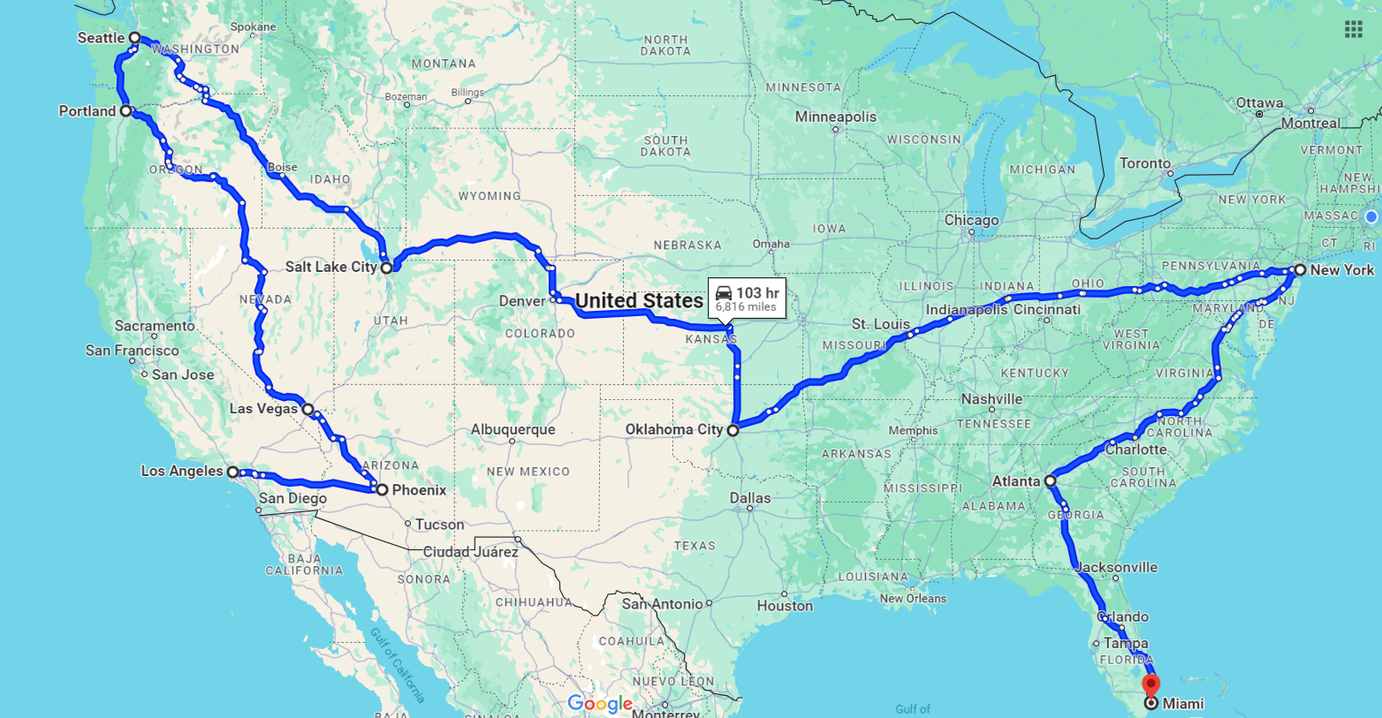
Coldplay Music of the Spheres US Tour 2024
Start and end in the biggest market cities
Most efficient route
Maintain hype throughout schedule

Slide 3
Schedule US leg between Europe (Aug) and Australia (Oct):
Sep 2nd (Mon): Los Angeles, California
Sep 4th (Wed): Phoenix, Arizona
Sep 6th (Fri): Las Vegas, Nevada
Sep 8th (Sun): Portland, Oregon
Sep 10th (Tue): Seattle, Washington
Sep 12th (Thurs): Salt Lake City, Utah
Sep 14th (Sat): Oklahoma City, Oklahoma
Sep 16th (Mon): New York City, New York
Sep 18th (Wed): Atlanta, Georgia
Sep 20th (Fri): Miami, Florida
Notes:
There not big events on these dates

Slide 4

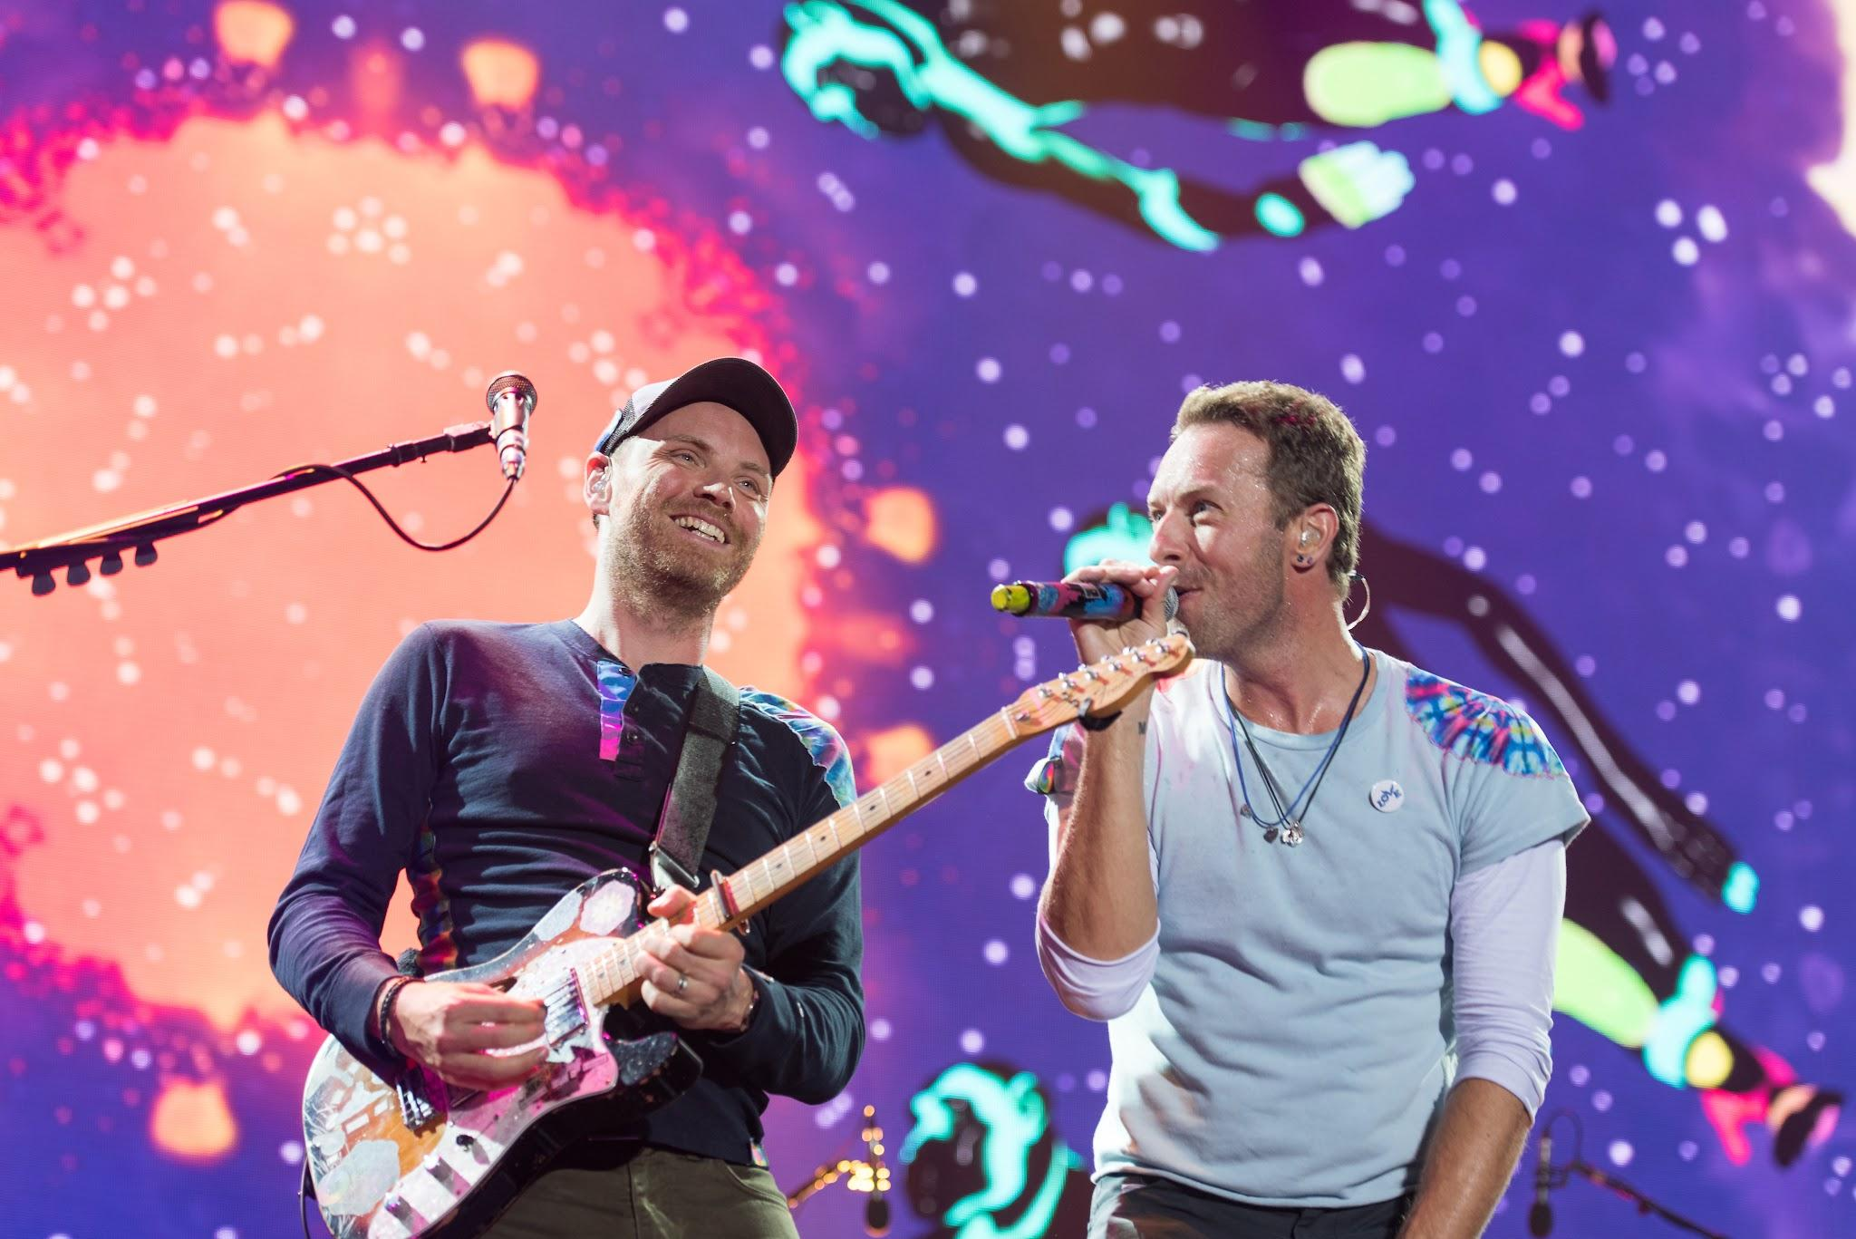
Our Goal
Maximize TM Revenue
Relevant for customers

Slide 5
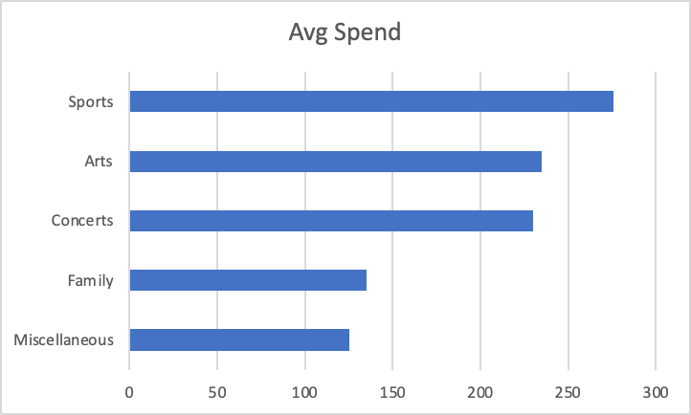
Maximize Revenue: Type of Event -> Concerts
Avg Spend per Event
Attendance per Event
Concerts: 2.5X Arts
 | Sum of dim_12_ind | Sum of dim_13_ind
Total | 148062 | 60171

Slide 6
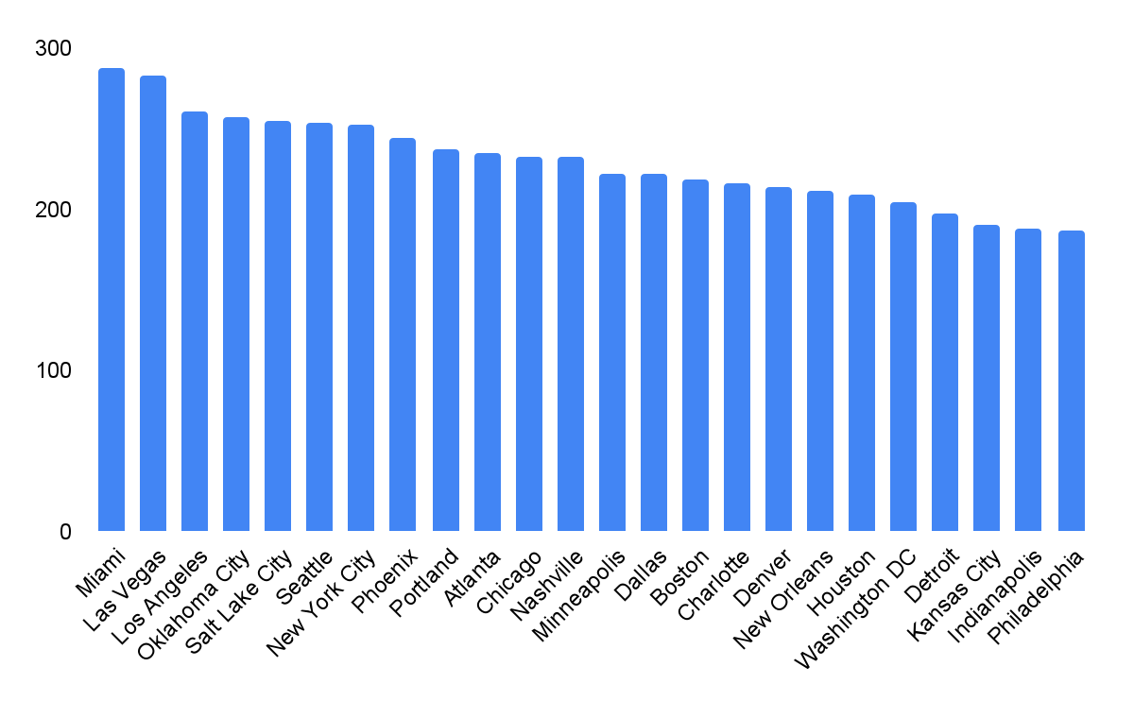
Maximize Revenue: City
Avg Spend per Concert event top 10 cities

Slide 7
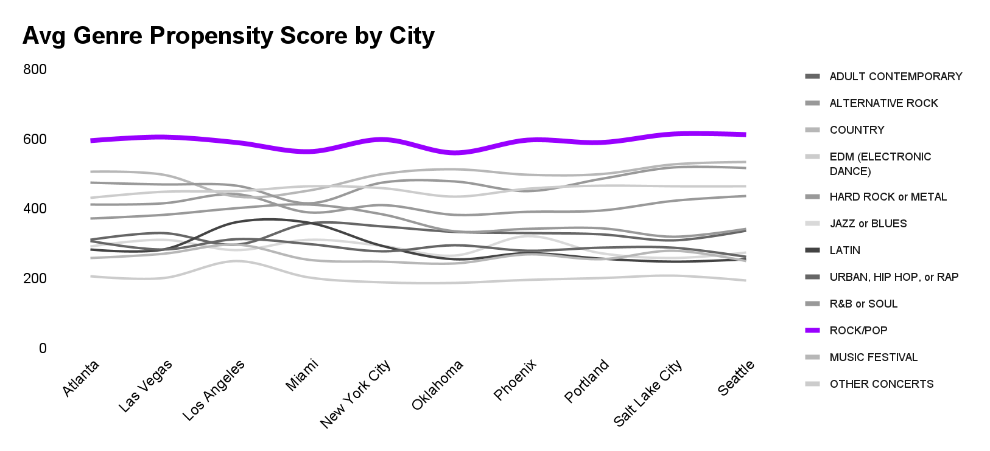
Maximize Revenue: Genre Propensity Score

Slide 8


Relevance for Customers:
PersonicX LifeStage Group:
+40%
Group 11B: Affluent Household
Group 15M: Top Wealth
Notes:
Earning years
Late careers with disposable income

Slide 9
Relevance for Customers:
Nostalgia
US not in tour
Biggest Band
September is free

Slide 10
THANK YOU!

